Slide 1

IBM Data Science Capstone
Battle of Neighbourhoods

Slide 2
TABLE OF CONTENTS :
INTRODUCTION
DATA SECTION
METHODOLOGY
RESULTS
DISCUSSION
ACKNOWLEDGEMENT
CONCLUSION

Slide 3

INTRODUCTION :
London is one of the most happening places in the UK. Famous for its lavish lifestyle and architecture ,it is one of the most preferred places to reside in.
However , owing to the expensive residences sided by the current economic and financial crisis , housing prices in London have been on an unprecedent rise causing real estate agencies to back out during the downfall.
Owing to the current scenario , it has indeed become difficult for families wanting to live in independent homes to buy houses of their choice at an affordable price.
Thus the question posed is – Is there affordable housing in London? if so where ?

Slide 4
AIM OF THE PROJECT :
The project aims at rendering support to those interested in buying their own homes,to help the make wise and effective decisions under ongoing financial and economic constraints.
Target audience :
Families or individuals wanting to purchase independent homes
Real estate agencies on the lookout for house sales
Business problem :
The question at hand is ‘Are there medium priced houses available for purchase in London? if so , is the construction sound or compromised in lieu with the minimal cost. Are there houses available in good localities with access to amenities such as hospitals , gyms , schools etc’. This project aims to address the above issue.

Slide 5
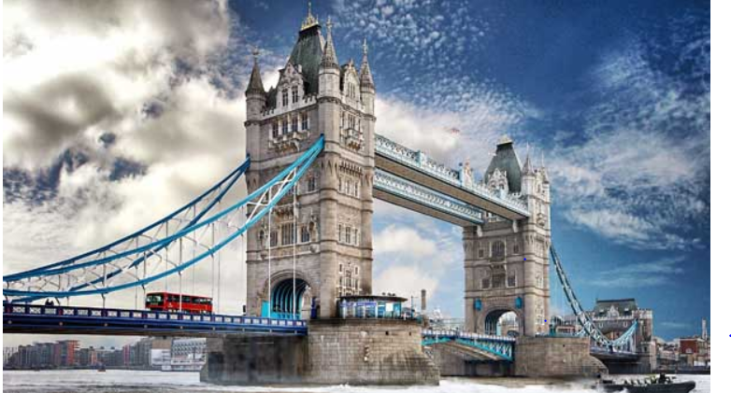
HOUSING AND PRICING PREFERNCES :
The average purchase price for a first time buyer in Greater and Central London is around £509,047 while in South East London it costs around £339,510.

